Slide 1
“BLOG”
Task - 2

Slide 2

BLOG
A blog, also known as a weblog, is a type of website resembling a diary or journal. It categorizes content into posts, which are displayed in reverse chronological order. This means that your most recent post appears at the top, pushing older posts downward. Blogs are accessible to anyone, enabling individuals to create and write on their own blog. Bloggers, the people who contribute to blogs, typically share their opinions and thoughts. If a blog primarily features video content, it's referred to as a video blog or vlog for short.
LMS Username | Name | Batch
au721220104022 | Manoj Kumar R | NM_CD1_12
au721220104032 | Praveen VG | NM_CD1_12
au721220104036 | Rajeshwari M | NM_CD1_12
au721220104051 | Surendran S | NM_CD1_12

Slide 3
Task-2
Creation of SRS & Github
Create SRS : “To-Do Planner”
Creation & Set-up of Github account
Creation & Hands-on to various commands of Git Bash
Evaluation Metric:
100% Completion of the above tasks
Learning Outcome
Get to know about different lifecycle models.
Understanding importance and how to create an SRS
Knowing various commands of Github
Understanding agile and scrum management techniques for efficient product development

Slide 4
Step-Wise Description
Choose a Platform: Select a blogging platform (e.g., WordPress).
Pick a Domain: Decide on a web address and hosting.
Customize Design: Personalize your blog's.
Create Content: Write and publish engaging posts.
Promote and Engage: Share on social media, engage with readers.
Summary of your task
A blog, short for weblog, is a website where individuals or organizations can publish content in the form of articles, images, and videos. Blogs typically present content in reverse chronological order, with the most recent posts at the top. Bloggers use various platforms to create and customize their blogs, making it easy to share their thoughts, opinions, and expertise on a wide range of topics. Blogs serve as a valuable platform for personal expression, information sharing, and community engagement, often allowing readers to comment on posts and interact with the authors.

Slide 5
Assessment Parameter
Gather requirements for the project
add Readme.md file with description of the project
Prepare database design schemas
Check-List
Commit all changes with "first commit"
Get your initial project Structure ready
create a repository on github related to project
Initiate a git repository
Push your changes to github

Slide 6
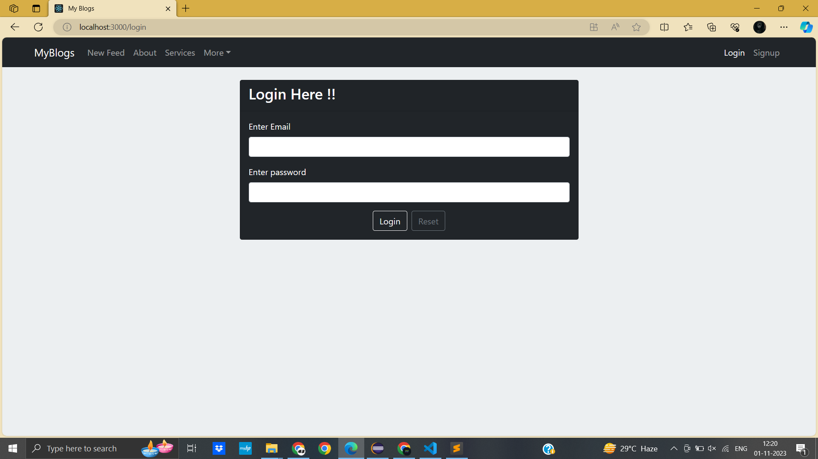
Login

Slide 7
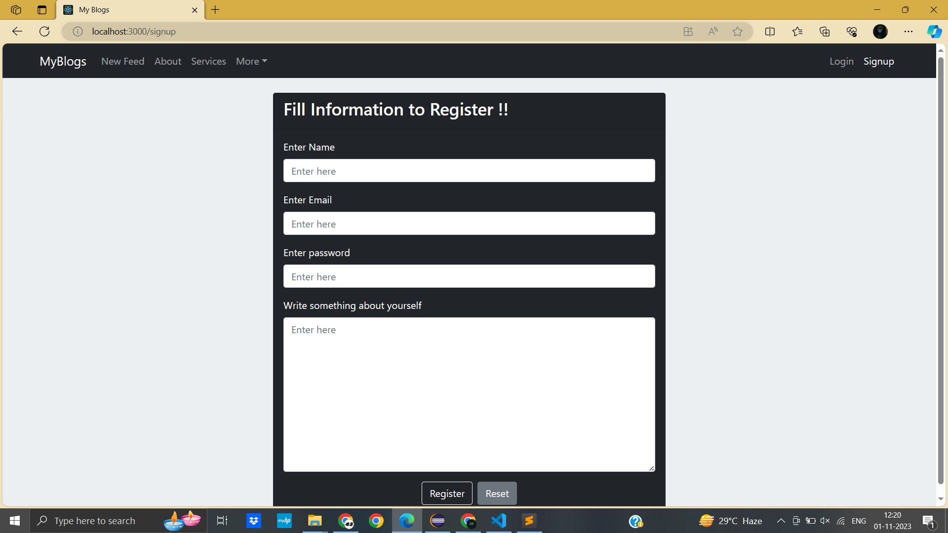
New Plan Page

Slide 8
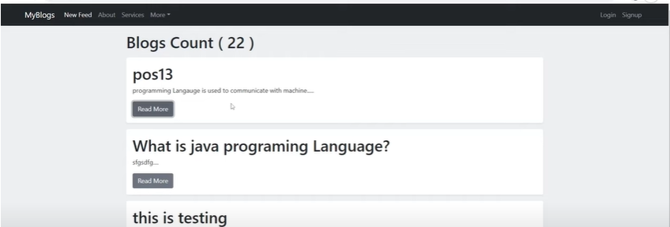
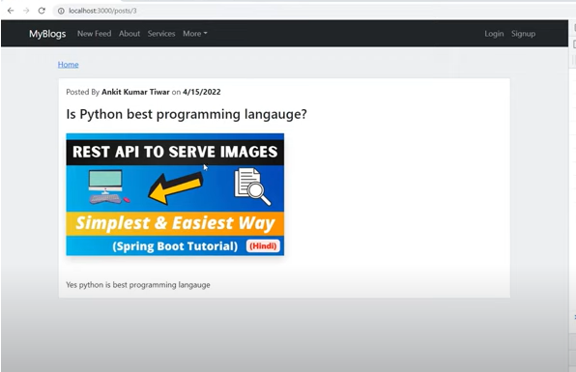
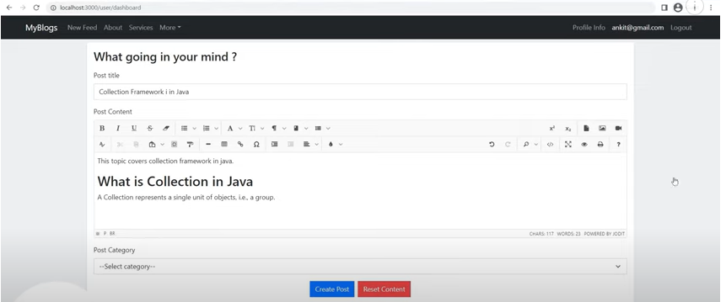
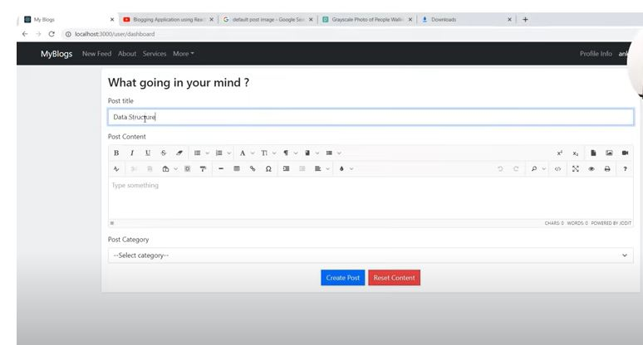
My Plan page

Slide 9
Submission Github
https://github.com/praveenvg1803

